Slide 1
SPARSHA
ASUTOSH COLLEGE
Data collected by: Asish Sahoo & Surama Bera
Academic year: 2023-24
Date: 23-12-2023

Slide 3
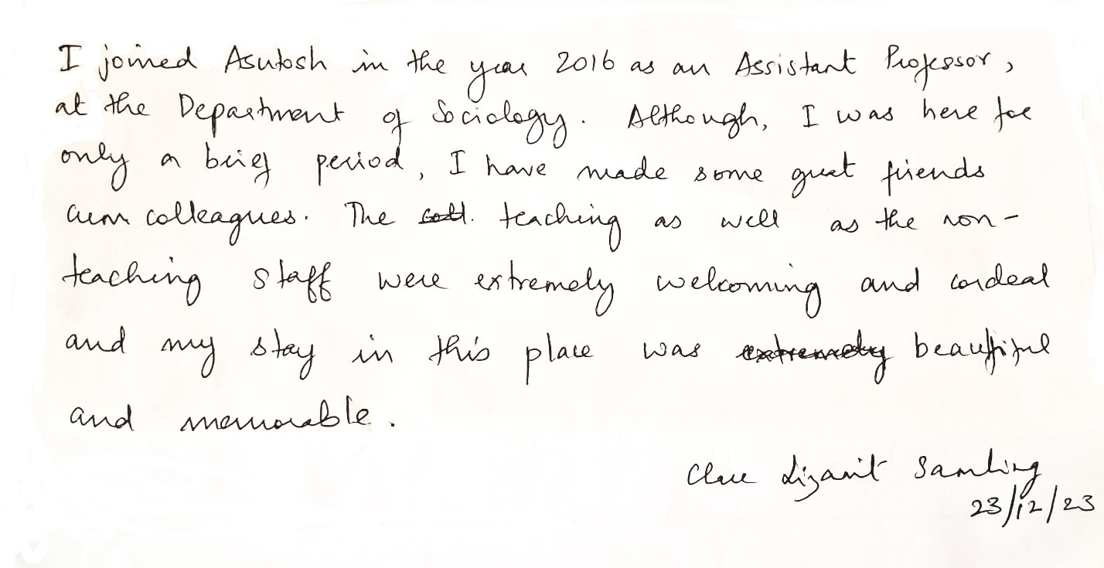

Slide 5
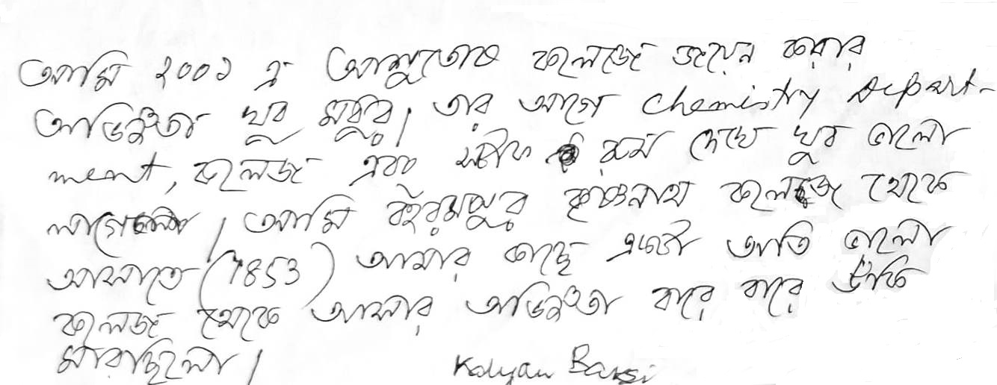

Slide 6
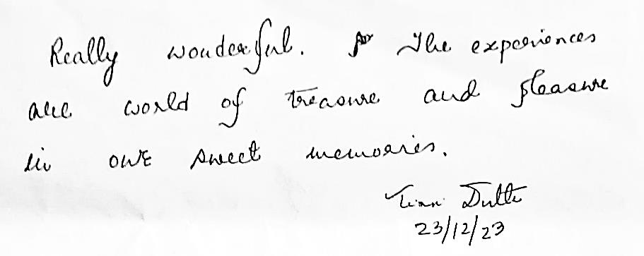

Slide 7
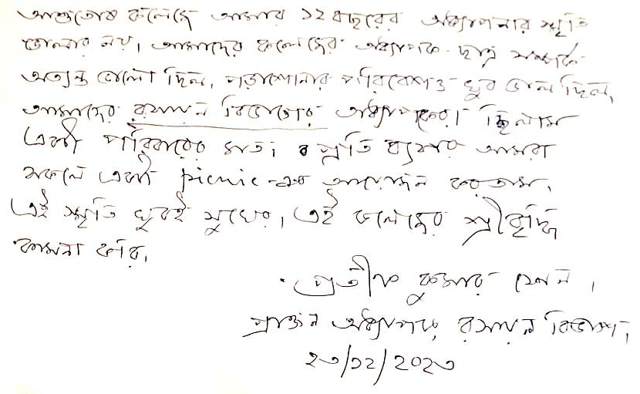

Slide 8
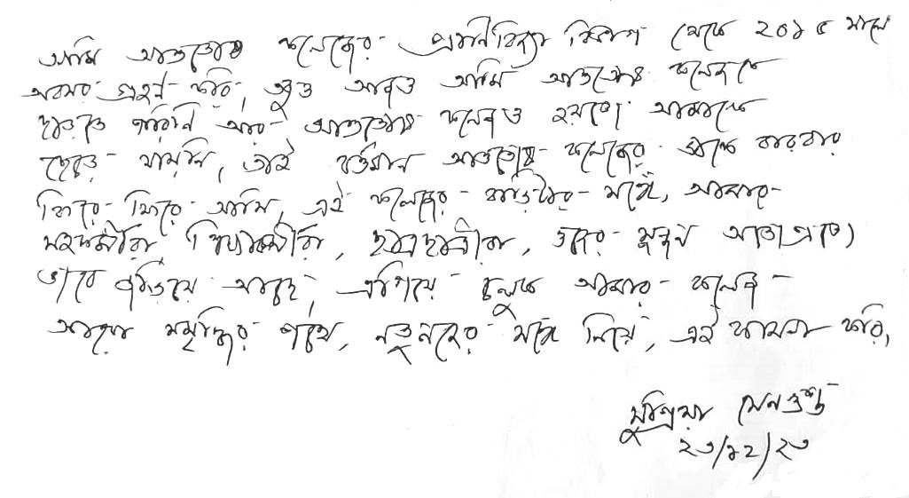

Slide 9
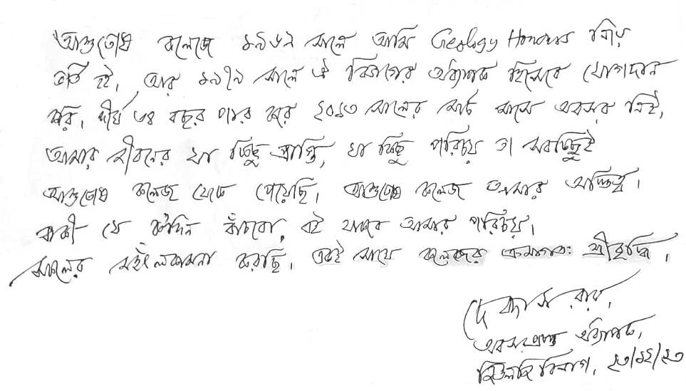

Slide 10
